Slide 1
Introduction to data science

Slide 2



Title and abstract
TITLE: MOVIE SUCCESS REVIEW
ABSTRACT: Success of a movie depends on various factors and different interest of aficionados. Movie creators have tried to find a constant formula which can say about the statistic of a movie being a success before its release but have failed to derive a solution . Given that major films costing over $100 million to produce can still flop , this question is more important than ever to the film industry.
Here we try to dig information of several thousand films and try to get an idea of which type of film are highly rated by viewers , whether they are commercial success or not using data on crew and cast , genre, plot etc.

Slide 3

Dataset
DATA DESCRIPTION : The dataset is from data.world website. It contains 28 variables for 5043 movies, spanning across 100 years in 66 countries. There are 2399 unique director names, and thousands of actors/actresses. “imdb_score” is the response variable while the other 27 variables are possible predictors.
DATASET LINK: https://data.world/data-society/imdb-5000-movie-dataset
NUMBER OF ROWS: 5,043
NUMBER OF COLUMNS: 28

Slide 4
Variable description
SL No | NAME | TYPE
1 | color | object
2 | director_name | object
3 | num_critic_for_reviews | float64
4 | duration | float64
5 | director_facebook_likes | float64
6 | actor_2_name | object
7 | actor_1_facebook_likes | float64
8 | gross | float64
9 | genres | object
10 | actor_1_name | object
11 | movie_title | object
12 | num_voted_users | int64
13 | cast_total_facebook_likes | int64

Slide 5
SL No | NAME | TYPE
14 | actor_3_name | object
15 | facenumber_in_poster | float64
16 | plot_keywords | object
17 | movie_imdb_link | object
18 | num_user_for_reviews | float64
19 | language | object
20 | country | object
21 | content_rating | object
22 | budget | float64
23 | title_year | float64
24 | actor_2_facebook_likes | float64
25 | imdb_score | float64
26 | aspect_ratio | float64
27 | movie_facebook_likes | float64
28 | actor_3_facebook_likes | float64

Slide 6
Steps that lead us to the conclusion
These are the steps that we will undertake:
Data Cleaning
Visualization and Analysis
Normalization
Correlation
Hypothesis Testing

Slide 7
Data cleaning
Data cleansing is a process in which you go through all of the data within a database and either remove or update information that is incomplete, incorrect, improperly formatted, duplicated, or irrelevant . Data cleansing usually involves cleaning up data compiled in one area.
Though data cleansing does and can involve deleting information, it is focused more on updating, correcting, and consolidating data to ensure your system is as effective as possible

Slide 8
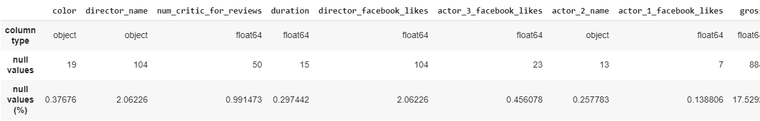
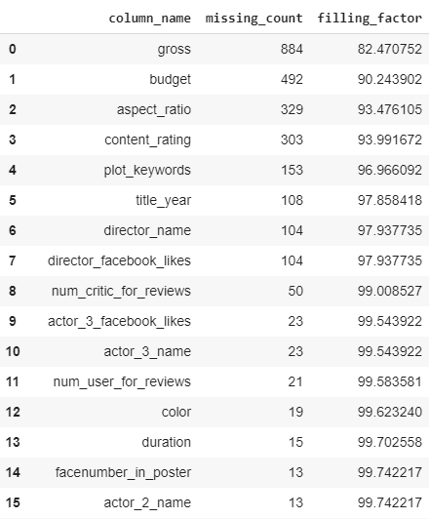
DATA BEFORE CLEANING

Slide 9
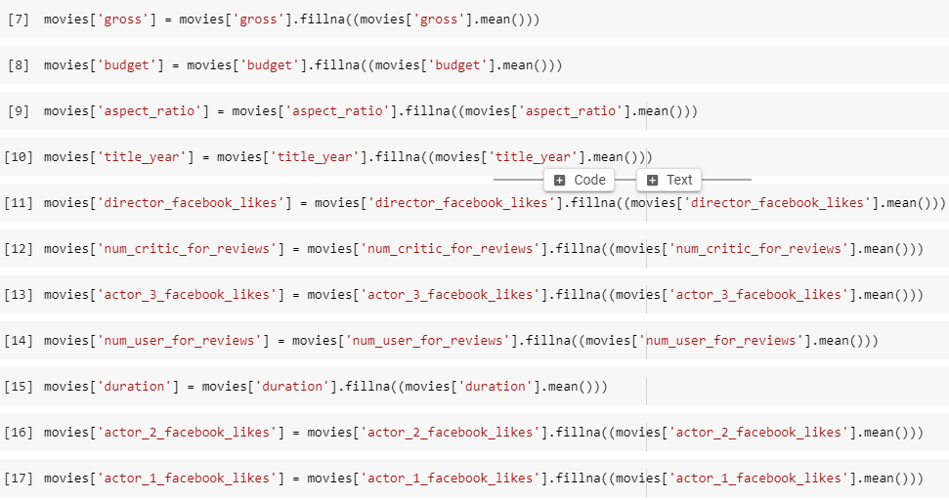
CLEANING PROCESS:
Replacing the missing values in Numerical data by their column’s mean value.

Slide 10

Cleaning categorical data by filling the missing data by using dataframe.ffill() function which fills the missing value in the dataframe . ‘ffill’ stands for ‘forward fill’ and will propagate last valid observation forward
Now removing the unwanted and irrelevant columns
new column which has cast popularity, it is derived from mean of actor’s ratings movies:
['popularity']=(movies['actor_1_facebook_likes']+movies['actor_2_facebook_likes']+movies["actor_3_facebook_likes"]).mean()
Similarly: Profit can be calculated by :
movies['profit']=movies['budget']-movies['gross']

Slide 11
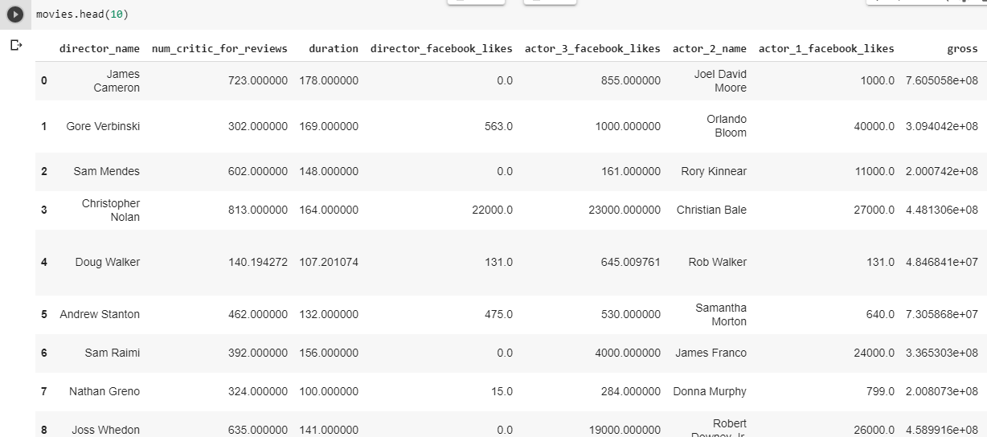
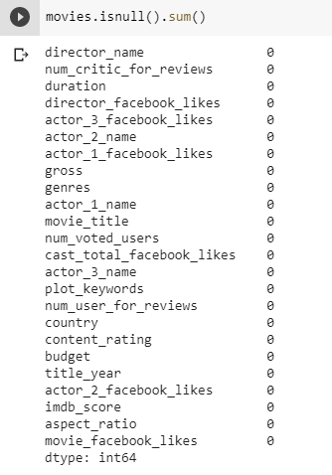

DATA AFTER CLEANING

Slide 12
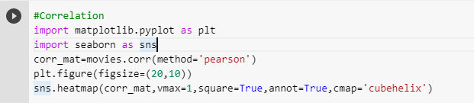
Correlation
Correlation is a statistical measure that indicates the extent to which two or more variables fluctuate together. A positive correlation indicates the extent to which those variables increase or decrease in parallel; a negative correlation indicates the extent to which one variable increases as the other decreases.
Here we will be using Pearson correlation :
In statistics, the Pearson correlation coefficient is a measure of the linear correlation between two variables X and Y. According to the Cauchy–Schwarz inequality it has a value between +1 and −1, where 1 is total positive linear correlation, 0 is no linear correlation, and −1 is total negative linear correlation.

Slide 13
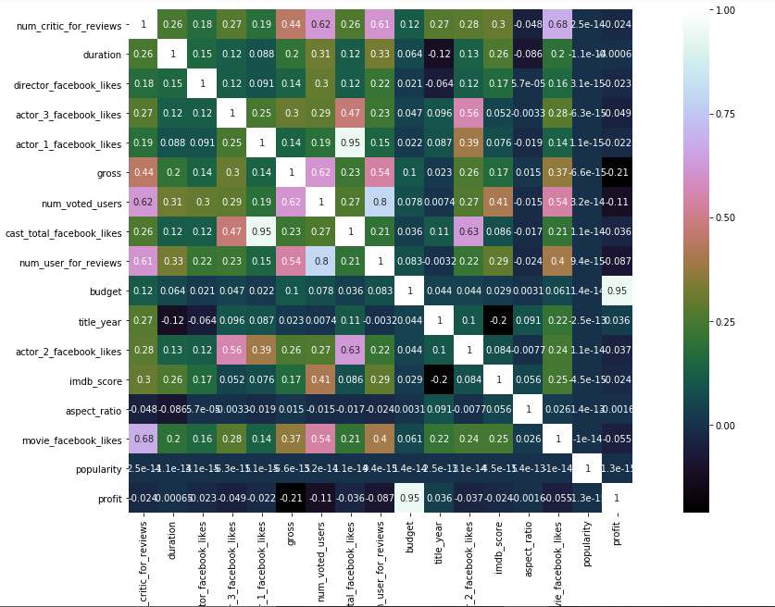
Each block in here shows the correlation between variables.
If their value is close to 1 they show a strong linear correlation.
Here the variable which have linear correlation are:
->profit vs budget etc.

Slide 14
Visualization
Data visualization is the act of taking information (data) and placing it into a visual context, such as a map or graph.
Data visualizations make big and small data easier for the human brain to understand, and visualization also makes it easier to detect patterns, trends, and outliers in groups of data.

Slide 15
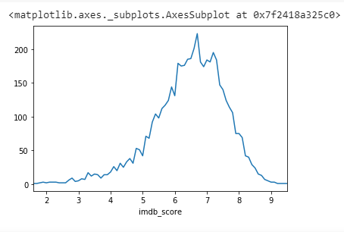
Number of movies vs imbd score
we can see more than 200 out of 5043 movies have rating of around 6.5
Generally people watch this kind of rating movies as number of user reviews for imdb score more than 6.5 is high

Slide 16
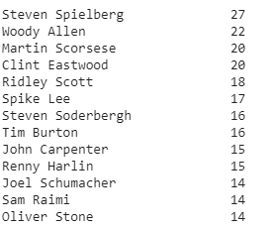
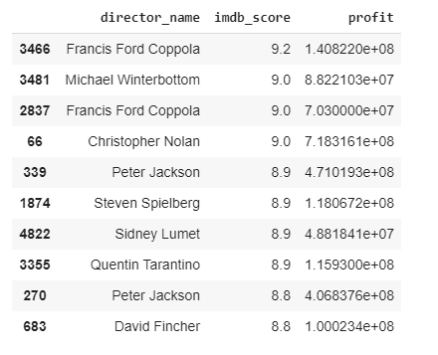
We have taken film count of each director.
We have made a separate table of directors
whose profit is high and imdb_score is more
than 7 and directors whose movie count is
more than 5.

Slide 17
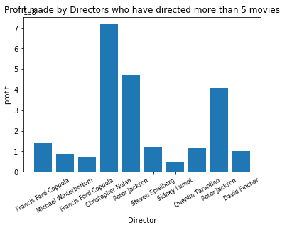
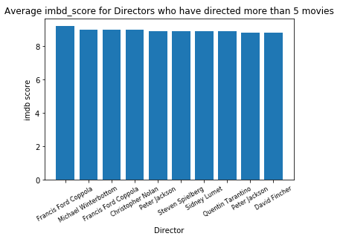
These are the directors who have directed more than 5 movies with the highest average profit.
As we can see Francis and Christopher have both good imdb_score and profit. So they have high chances of making successful movies on an average
And these are the directors who have directed more than 5 movies with the highest average movie rating.
As we can see most of them have high score, so we can say experience of director help in success of a movie
Francis Ford Movies have more imdb_score in average

Slide 18
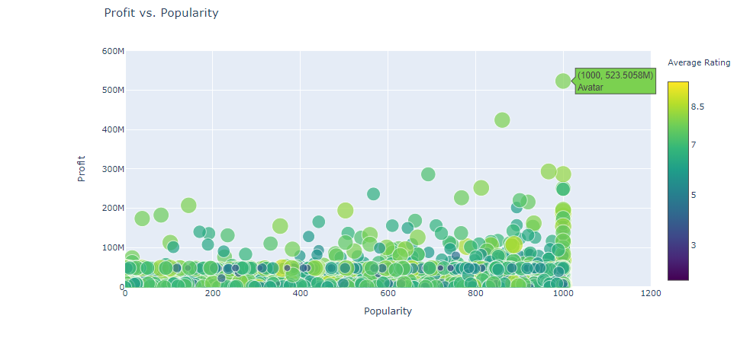
The above plot displays the profit of a movie versus popularity of movie cast. The color and size of the markers represents the average imdb score out of 10 given to the movie. There is some positive correlation between profit and popularity, so companies that have popular cast seem to actually see the benefits higher profits. profit increases with popularity of actors
imdb_score independent of actors popularity
If you hover over the highest point on the graph, you’ll learn that ‘Avatar’ is the most profitable movie ever.

Slide 19
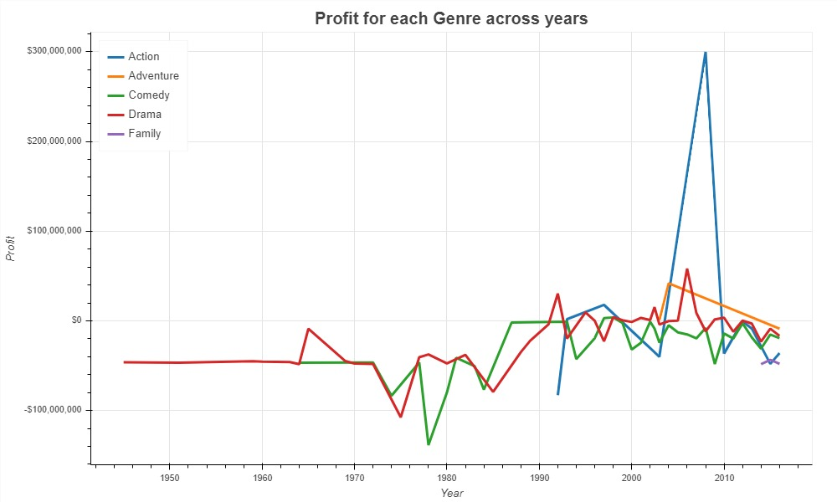
The below plot displays the trend in movie profit over time for different genres. It appears that movies of the ‘Action’ and ‘Adventure’ genres are becoming increasingly more profitable recently, and ‘Comedy’ movies have been generating less profit recently.

Slide 20
Takeaways
Action and Adventure movies tend to be most profitable as of late.
The average movie imdb rating has been around 6.5.
James Cameron is the director whose movies make the most average profit.
Christopher Nolan is the director whose movies get the highest average rating
Francis Ford and Christopher Nolan have both good imdb_score and profit. .
Avatar is the most profitable movie ever.

Slide 21
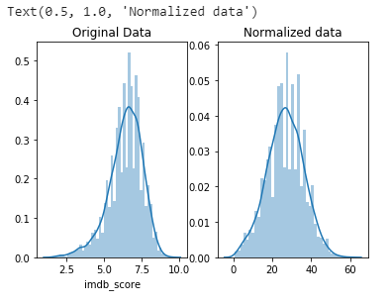
Normalization
Normalization is a technique often applied as part of data preparation. The goal of normalization is to change the values of numeric columns in the dataset to a common scale, without distorting differences in the ranges of values.
Commonly when the relationship between two dataset is non-linear we transform data to reach a linear relationship. Here, normalization doesn't mean normalizing data, it means normalizing residuals by transforming data. So normalization of data implies to normalize residuals using the methods of transformation.

Slide 22
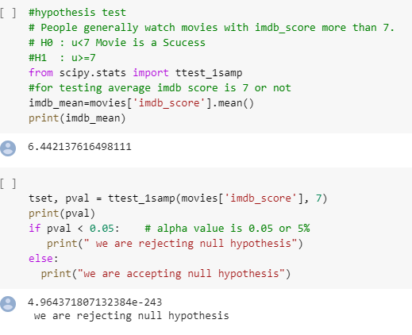
Hypothesis testing
The theory or methods, and practice of testing a hypothesis by comparing it with the null hypothesis. The null hypothesis is only rejected if its probability falls below a predetermined significance level, in which case the hypothesis being tested is said to have that level of significance.

Slide 23


